Slide 1

Internship Program: Soulvibe.Tech
“Relational Data Analysis:
Insights from the CollegeCourses Dataset”
NAME: BHUKYA BHAVANI KISHORE
Batch Name: SVT/DAINT/2025/06/B10

Slide 2

Introduction
Overview of the main objectives
My main objective for this task was to evaluate my ability to query, manipulate, and analyze relational data using SQL. I used the "Higher Education Course" dataset to write queries and extract meaningful insights from it. The data was assumed to be available in a SQL Server database, specifically within a table named 'CollegeCourses'.

Slide 3
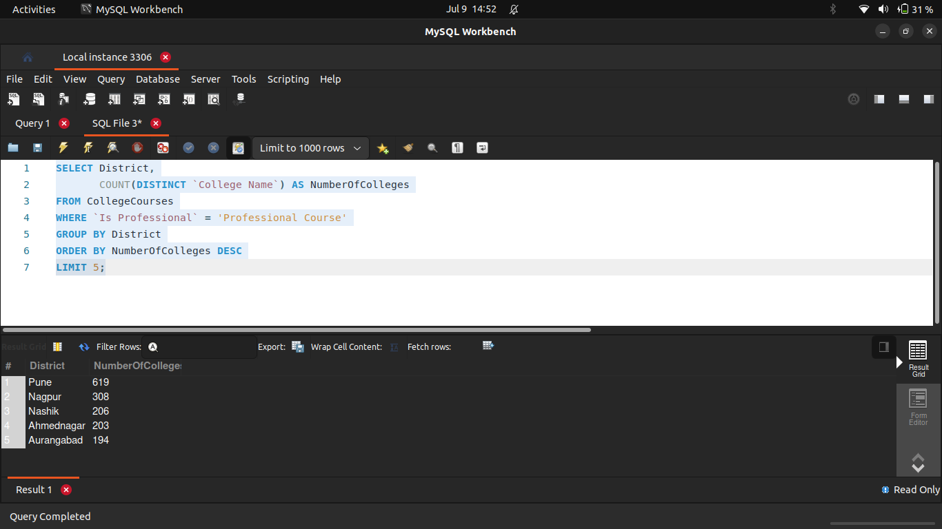
Find the top 5 districts with the highest number of colleges offering professional courses.
1

Slide 4
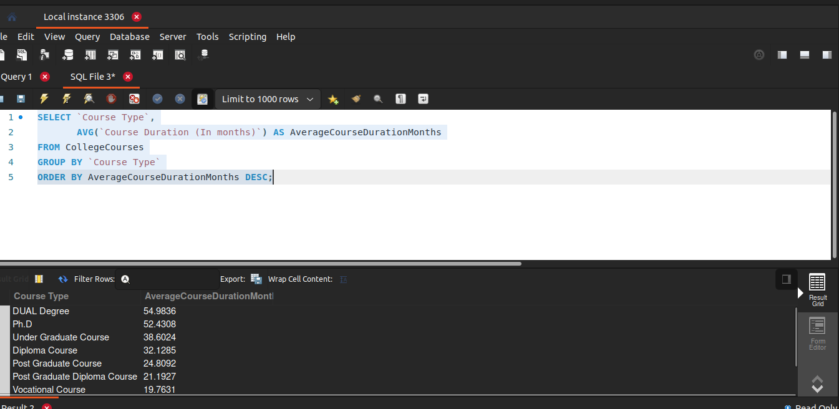
Calculate the average course duration (in months) for each Course Type and sort them in descending order.
2

Slide 5
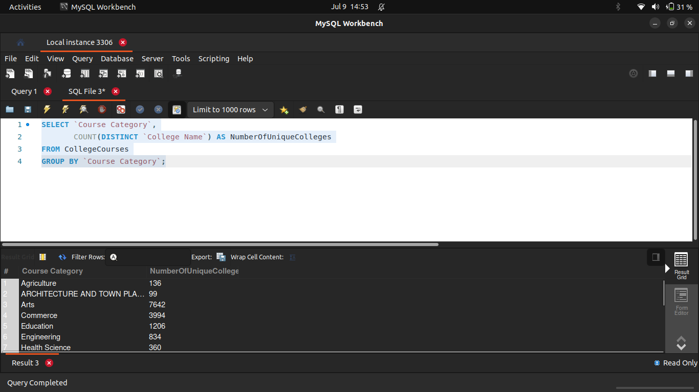
3 Count how many unique College Names offer each Course Category.

Slide 6
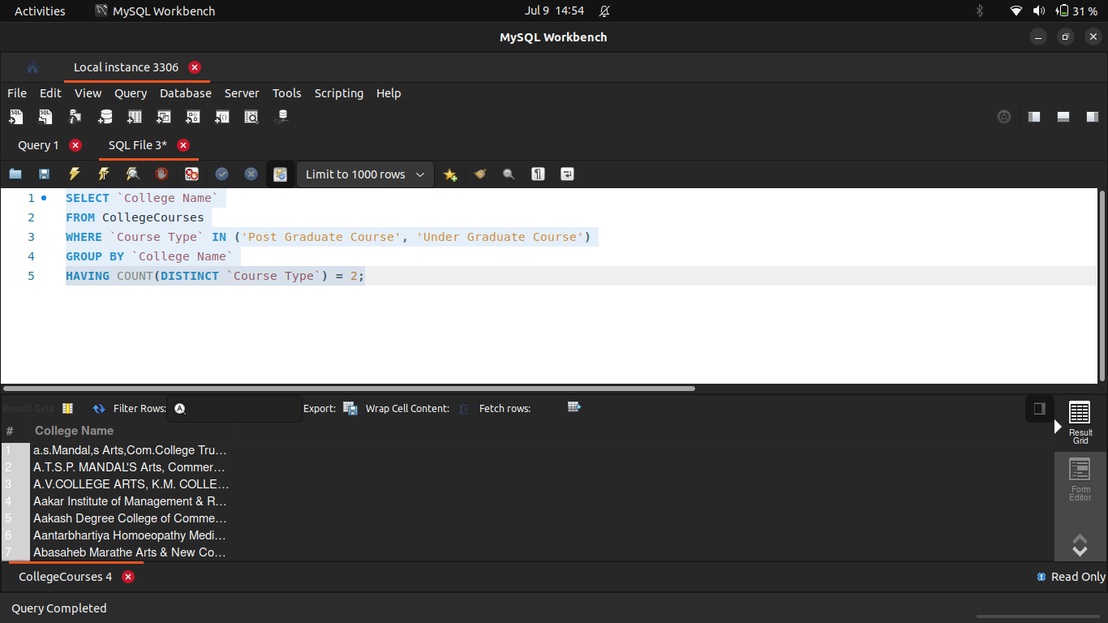
Find the names of colleges offering both Post Graduate and Under Graduate courses.
4

Slide 7
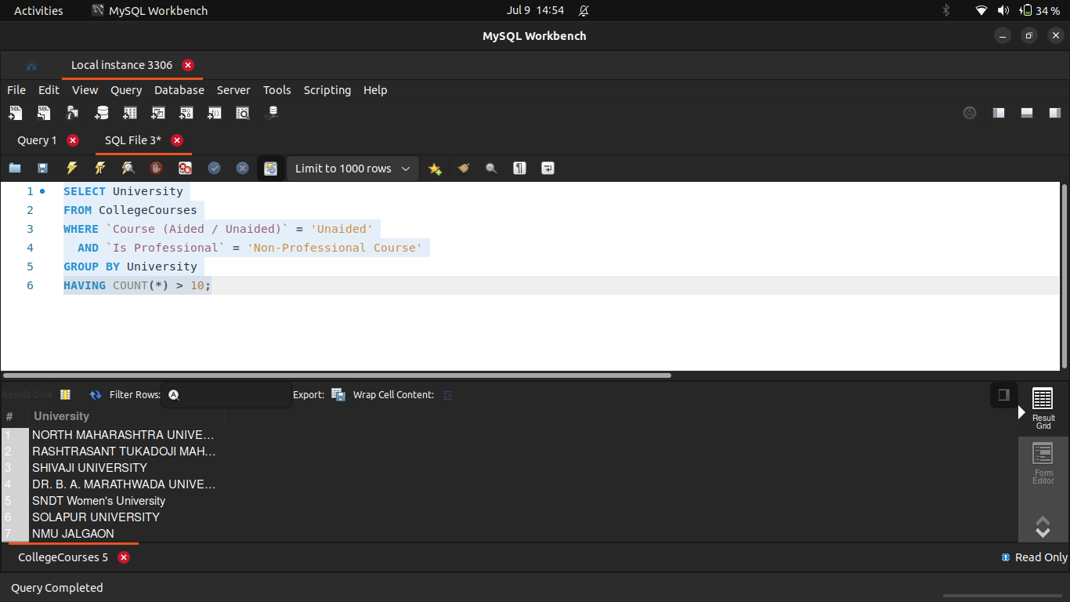
5 List all universities that have more than 10 unaided courses that are not professional.

Slide 8

6 Display colleges from the "Engineering" category that have at least one course with a duration greater than the category’s average.

Slide 9
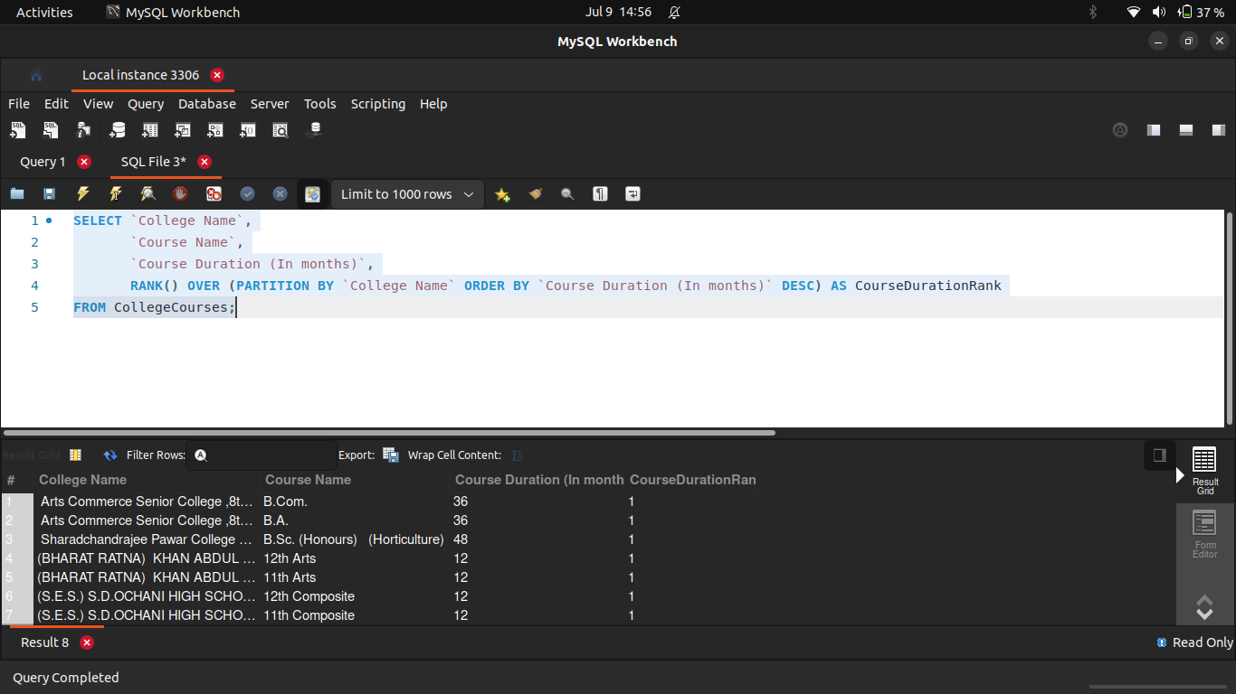
Assign a rank to each course within a College Name based on course duration, longest first.
7

Slide 10
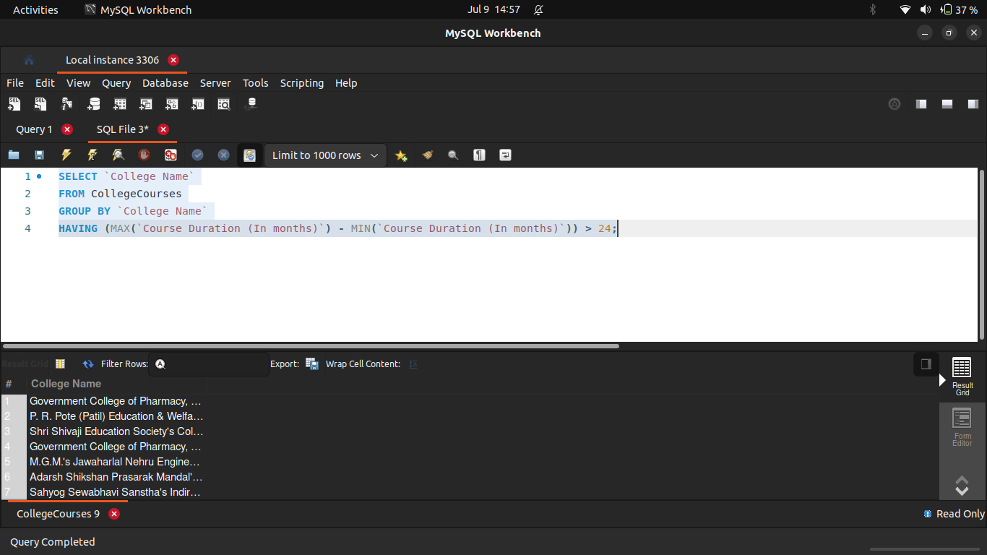
Assign a rank to each course within a College Name based on course duration, longest first.
8

Slide 11
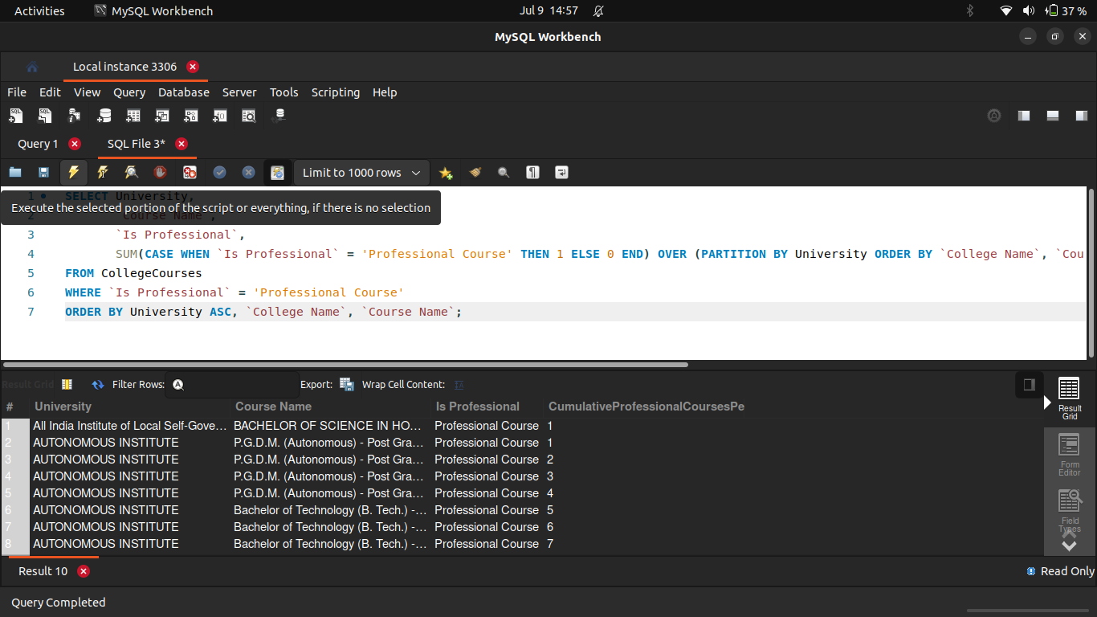
9 Show the cumulative number of professional courses offered by each university sorted alphabetically.

Slide 12
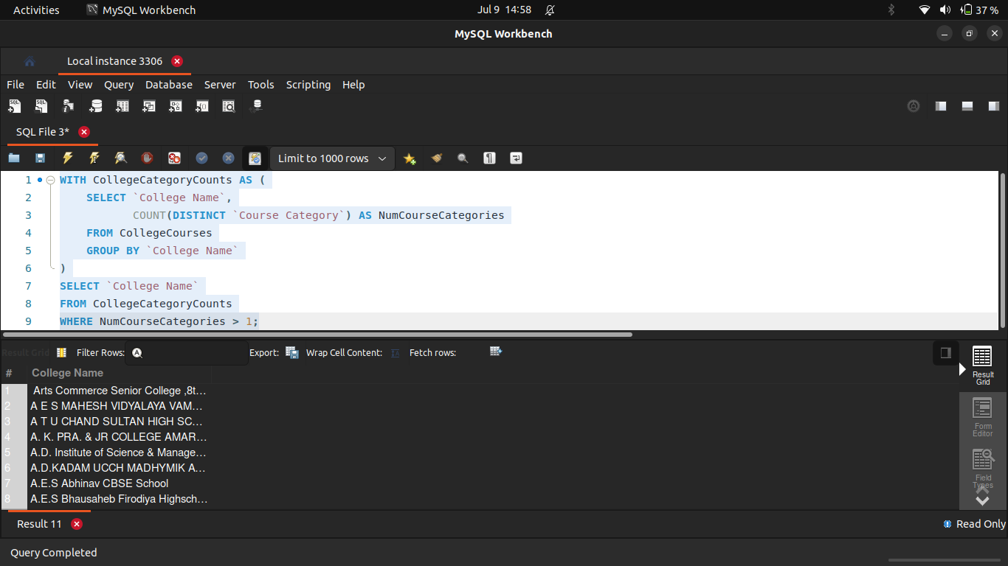
Using a self-join or CTE, find colleges offering more than one course category.
10

Slide 13
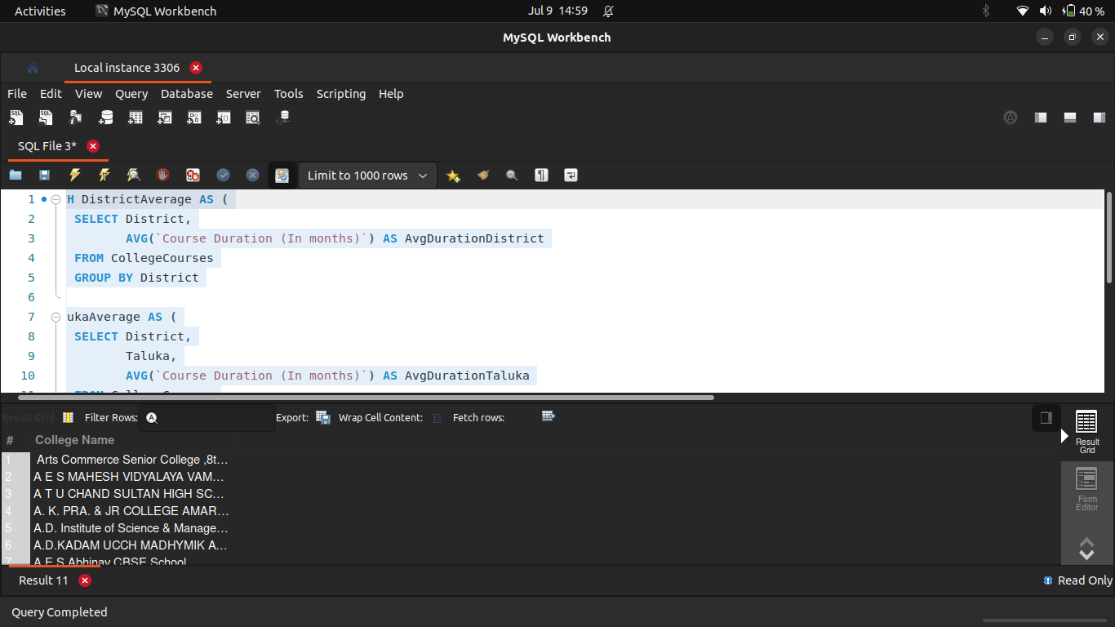
11 Create a temporary table (CTE) that includes average duration of courses by district and use it to list talukas where the average course duration is above the district average.

Slide 14
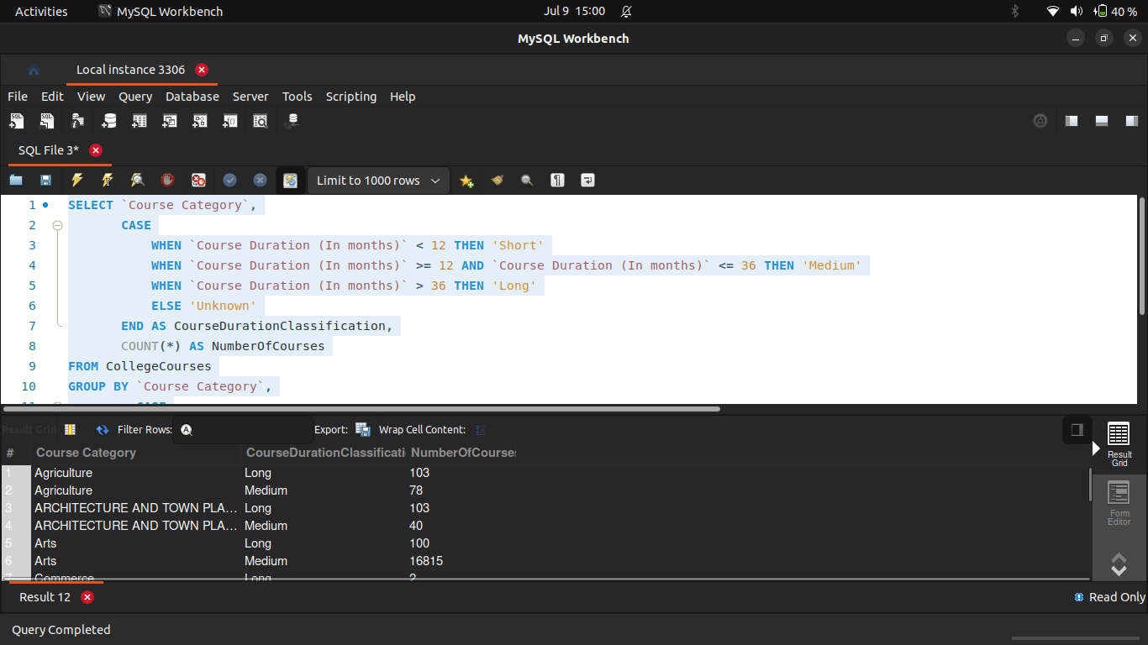
12 Create a new column classifying course duration as: Short (< 12 months),Medium (12-36 months),Long (> 36 months) Then count the number of each duration type per course category.

Slide 15
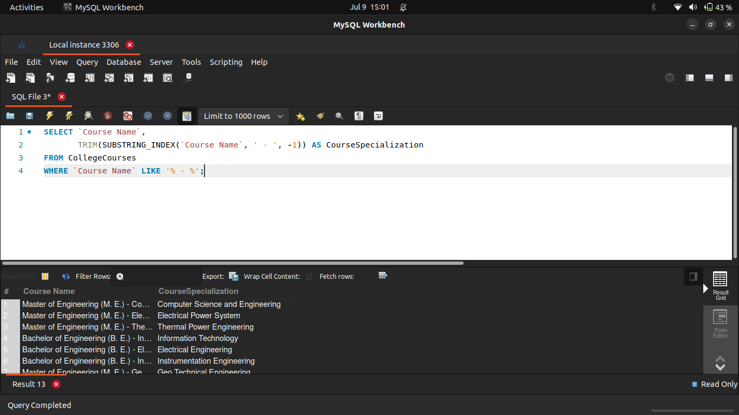
Extract only the course specialization from Course Name. (e.g., from "Bachelor of Engineering (B. E.) - Electrical", extract "Electrical")
13

Slide 16
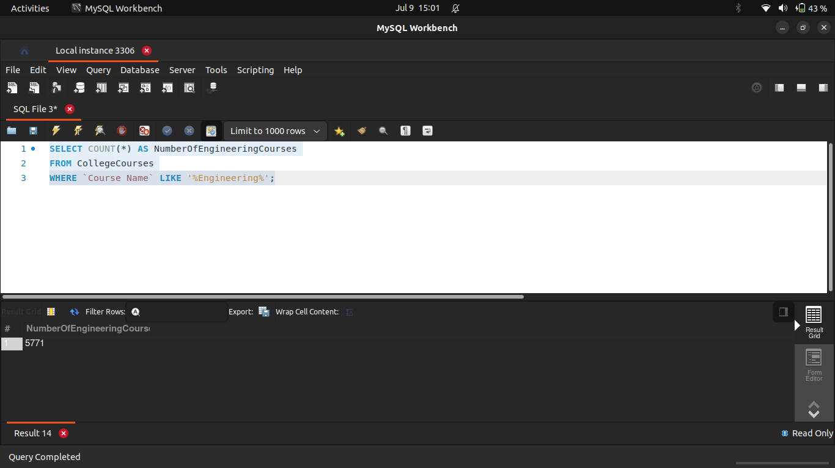
14 Count how many courses include the word Engineering in the name.

Slide 17
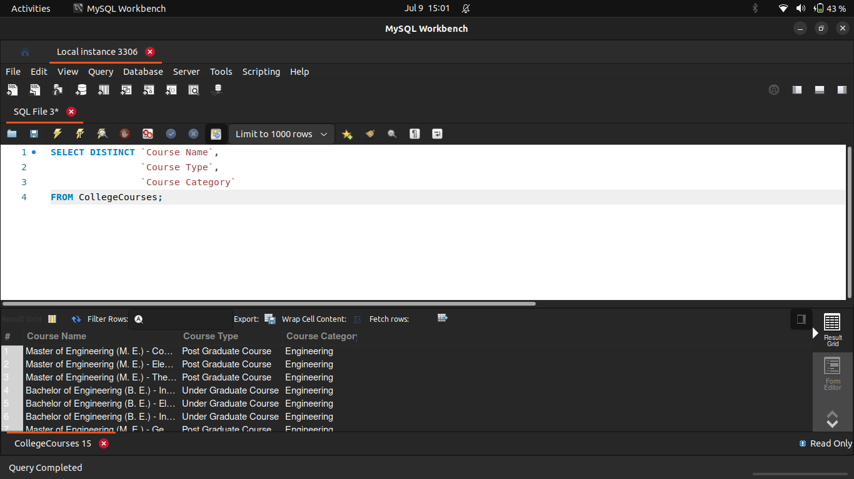
15 List all unique combinations of Course Name, Course Type, and Course Category.

Slide 18
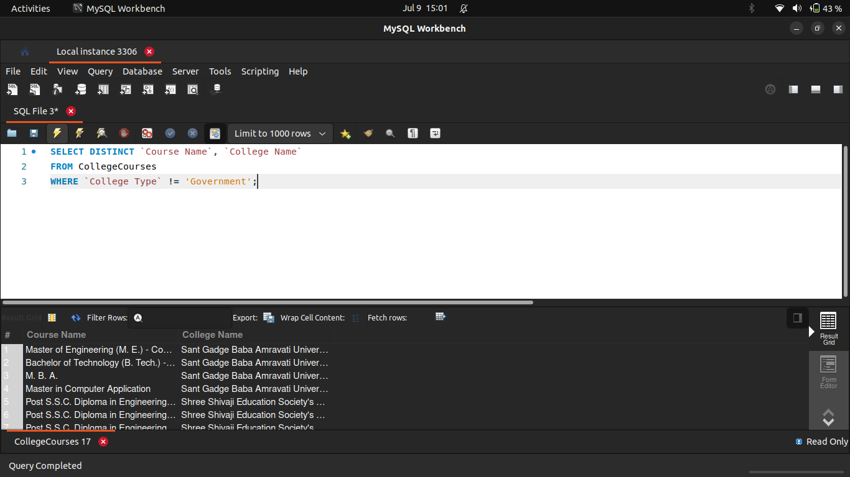
16 Write a query to get all courses that are not offered by any Government college.

Slide 19
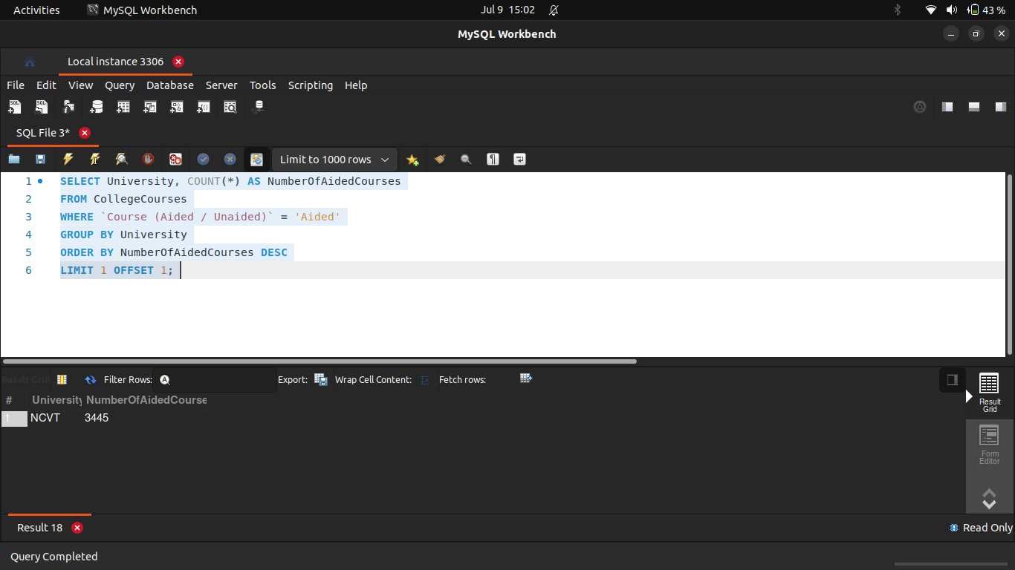
17 Find the university that has the second-highest number of aided courses.

Slide 20
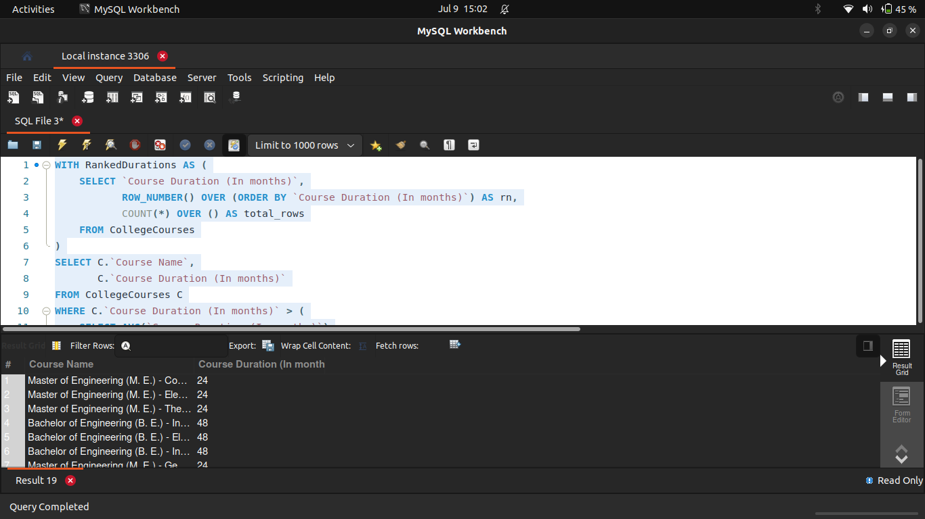
18 Show courses whose durations are above the median course duration.

Slide 21
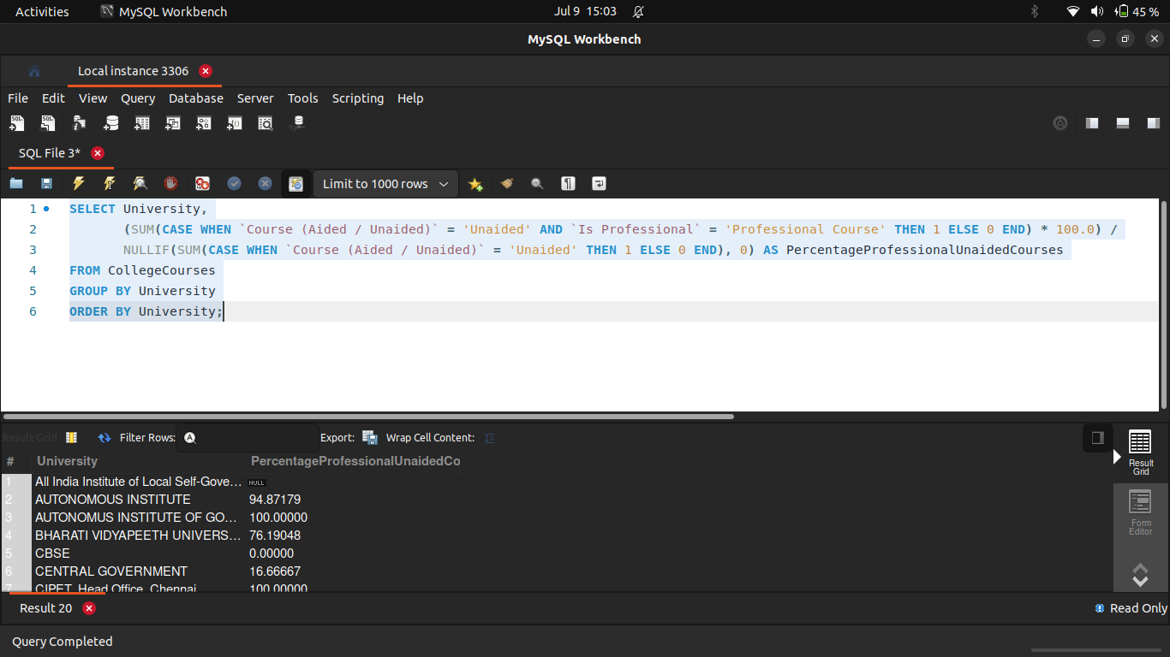
19 For each University, find the percentage of unaided courses that are professional.

Slide 22
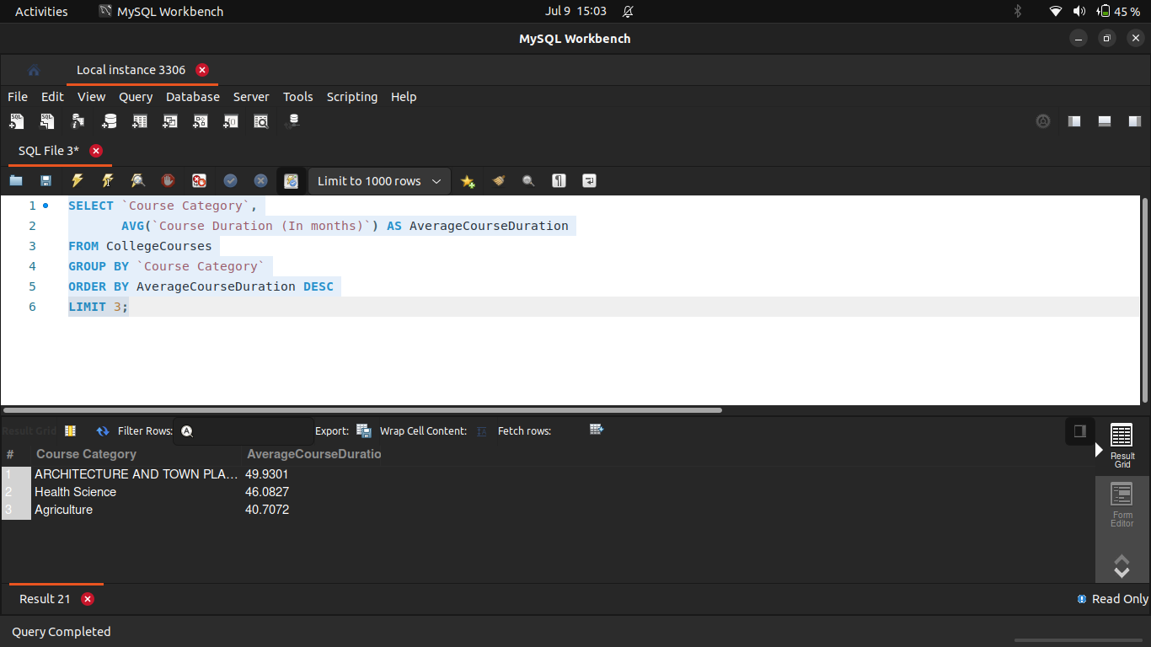
20 Determine which Course Category has the highest average course duration and display the top 3.

Slide 23

Conclusion
Through this SQL-based exploration of the CollegeCourses table, I gained hands-on experience in extracting, filtering, grouping, and summarizing educational data effectively. By writing and analyzing 20 different queries, I was able to:
Analyze Program Professionalism and Aided Status: I examined the distribution of professional versus non-professional courses and the balance between aided and unaided programs across different institutions.
Evaluate College and University Landscapes: I identified top districts for professional courses, colleges offering diverse categories, and universities with specific course profiles.
Understand Course Offerings and Tends: I delved into the types of courses offered, their durations, and classifications (short, medium, long), which helped me see patterns in educational programs.
Gain Geographic Insights: I explored how course durations vary by district and taluka, providing a geographical perspective on educational offerings.
Perform Category and Type Analysis: I analyzed unique combinations of course names, types, and categories, and counted courses within specific categories like 'Engineering'.
My Key Takeaways:
I found that SQL is an incredibly powerful tool for performing deep data analysis with precision, especially when dealing with structured datasets like this one.
Writing these queries helped me profoundly understand the structure and relationships within the CollegeCourses dataset, revealing nuances I wouldn't have seen otherwise.
These insights, which I've extracted, can be leveraged for strategic decisions in the higher education sector, such as identifying gaps in course offerings, understanding regional educational needs, or even planning for future program development.
Ultimately, this data exploration using SQL has laid a strong foundation for more advanced analytics and visualization, potentially in tools like Power BI or Tableau, to present these findings even more compellingly.

Slide 24
Thank You

